Slide 1
Freshman RPG Iteration #2
Companion App

Slide 2
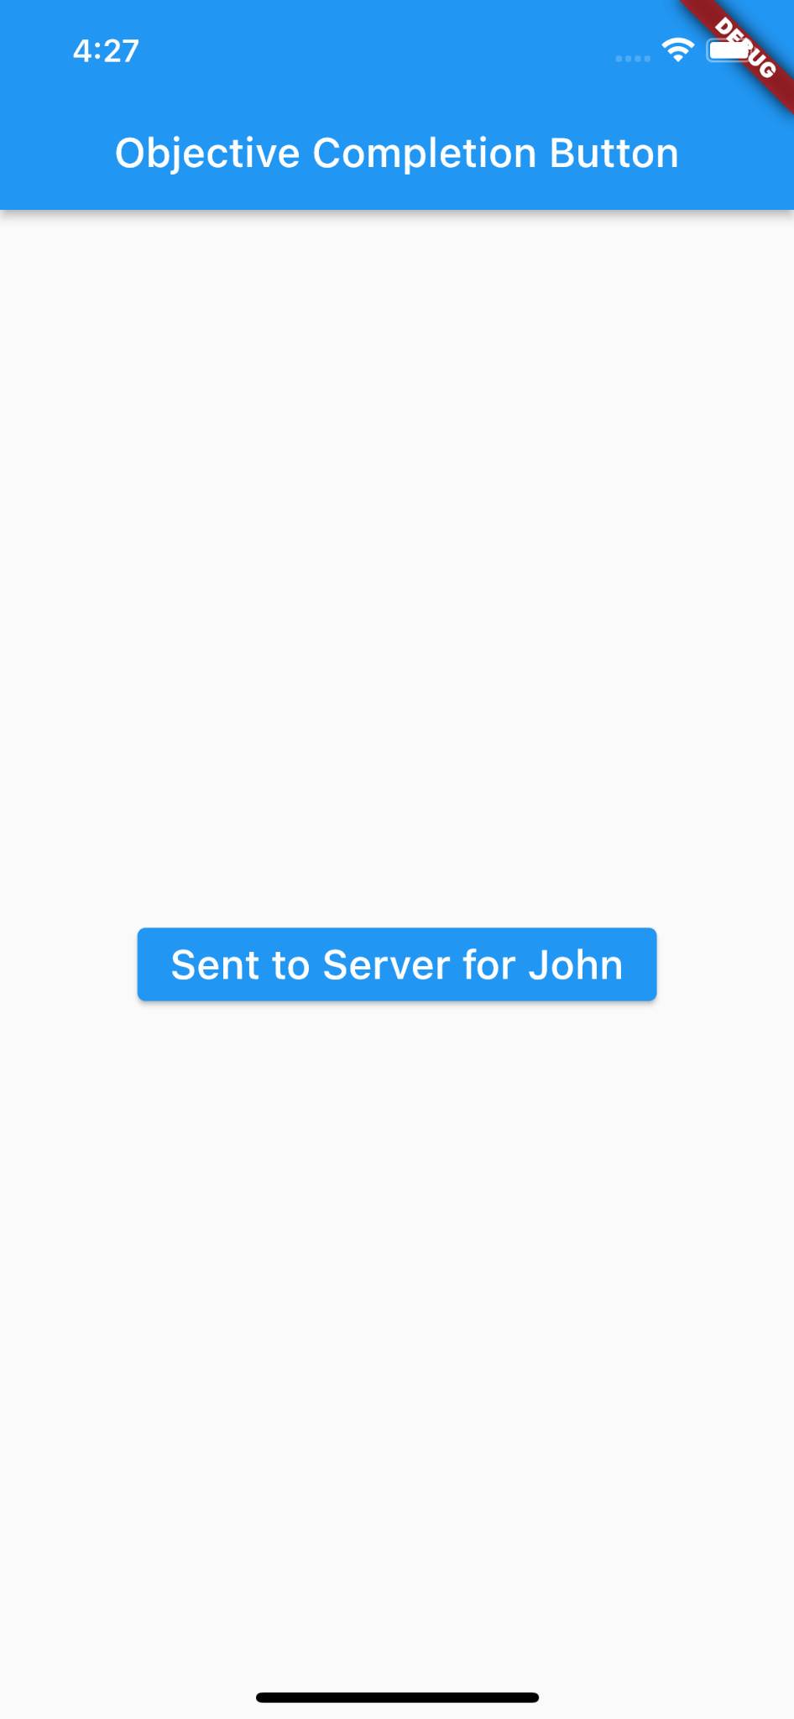
Our Goal
The user should be able to complete external objects from an app
Right now this is done by clicking a button

Slide 3
Current Limitations
Right now, we can only complete a single objective for one player
This is can be changed later

Slide 4
What We Can Do in the Future
QR Code
User Login
GPS Location
App Icon

Slide 5
TIME FOR
A DEMO

Slide 6
Any Questions?

